Slide 1
ML@NOVA: [CDT]
The three-body problem

Slide 2
Team identification
Name: Duarte Coelho
Number: 69900
Name: Tomás Martins
Number: 69898
Name: Carlota Gonçalves
Number: 69934
Final score: 1.17405
Leaderboard private ranking: 28

Slide 3
Task [1.1]
Notes:
Replicate this section for every task. Add slides as needed

Slide 4
What was done in task [1.1]
Dataset exploration and trajectories visualization:
Look into the dataset, in order to understand the dataset and how it reacts for different situations;
See different trajectories, in order to understand how the masses move during time.
Clean the dataset:
Remove anomalies or unnecessary data (i.e.: collisions, velocities, initial positions);
Make sure there are no dependencies or duplicated entries, to do the spliting.
Dataset preprocessing:
Add the initial positions of each iteration of positions.
Split the dataset:
Split the dataset randomly between training and validation sets, with 80% to train and 20% to validate.

Slide 5
What was done in task [1.1]
Clean the dataset:
Remove the unnecessary big amount of 0.0, due to the colisions:
Remove data that was not giving any information;
By removing this lines, it was easier to find the initial positions.
Remove velocities that were not being used in this model:
These columns will be ignored.
Remove initial positions from the dataset:
Since the solution would be to predict the positions of the masses, depending on the initial positions and time > 0.0, the initial positions were removed because the model already has that answer, and it should predict the other positions and not the initial.
Dataset preprocessing:
Add columns to identify the initial positions:
These columns will be used as features;
Having a connection for each position to its initial position.

Slide 6
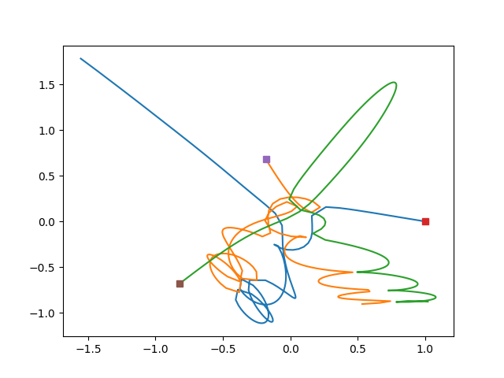
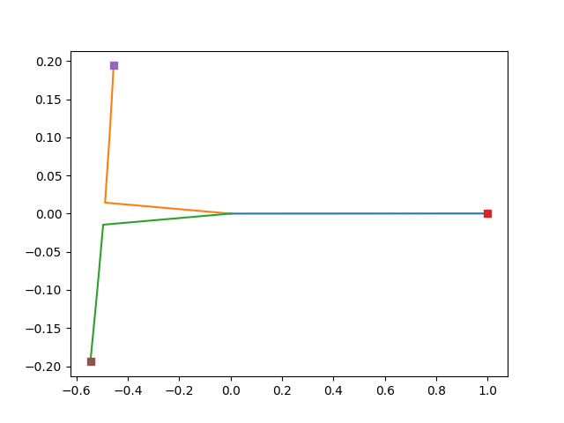
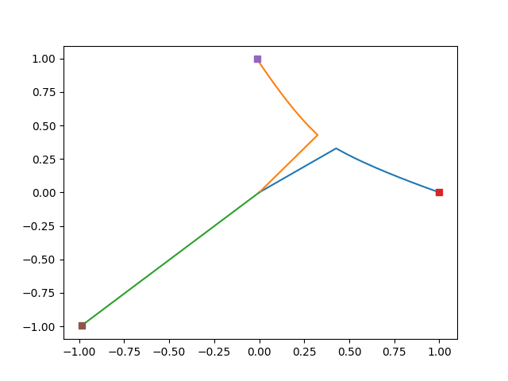
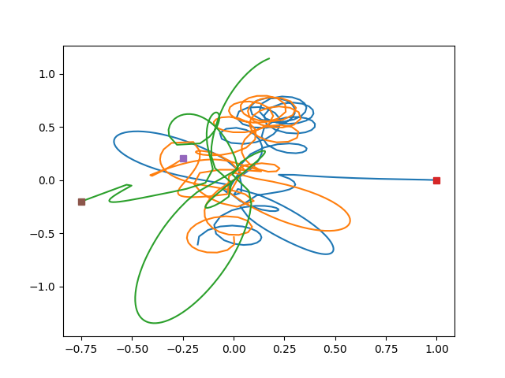
What was done in task [1.1]
Dataset exploration and trajectories visualization:

Slide 7
Analysis
Data exploration and understanding:
On the left side of the images:
There are two trajectories where the masses collide;
With this it was possible to identify the amount of 0.0 lines, after the collision.
On the right of the images:
There is one trajectorie, the one above, where one of the masses “lost” its way, and the other two started an infinite loop;
The other trajectorie, it’s more difficult to analyse, due to the complex relationship between the masses. It’s possible to see that, the masses purple and red, entered into an infinite loop, and the other one starts to go away.
Importance:
The data exploration was crucial to identify the behavior of the masses, between each other, and identify non-significant data and anomalies, within the trajectories.

Slide 8
Task [1.2]
Notes:
Replicate this section for every task. Add slides as needed

Slide 9
What was done in task [1.2]
Identify features and outputs:
Features are the initial positions and time;
Outputs are the positions of the masses at each point in time, it’s what should be found.
Build the pipeline:
Create the pipeline;
Fitting the pipeline;
Making predictions.
Create a DataFrame for submission:
A csv file is created to submit to Kaggle.
Print and examine the plot:
Calculate the RMSE as the square root of the mean square error;
Plotting the true final positions against the predicted final positions.

Slide 10
What was done in task [1.2]
Build the pipeline:
Create the pipeline:
Consists in two steps: standard scaling and linear regression;
The StandardScaler is used to remove the mean and scaling to unit variance;
The LinearRegression model is used for analysis.
Fitting the pipeline:
Fit all the features and transform the data, fit the transformed data using the final estimator.
Making predictions:
Made on the training, validation and test sets using the predict method of the pipeline;
Store the predicted values.

Slide 11
What was done in task [1.2]
Create a DataFrame for submission:
A csv file is created to submit to Kaggle:
The csv needs to be on a specific structure, so the columns were renamed and a column id was added.
Print and examine the plot:
Calculate the RMSE as the square root of the mean square error:
Calculated for the training and validation sets.
Plotting the true final positions against the predicted final positions:
The method plot_y_yhat has two arguments as entry: y_val and y_pred, which are the true final positions and the predicted final positions, respectively;
From the next image (image of the plot), the diagonal represents the true values and the blue “cloud” are the predicted values.

Slide 12
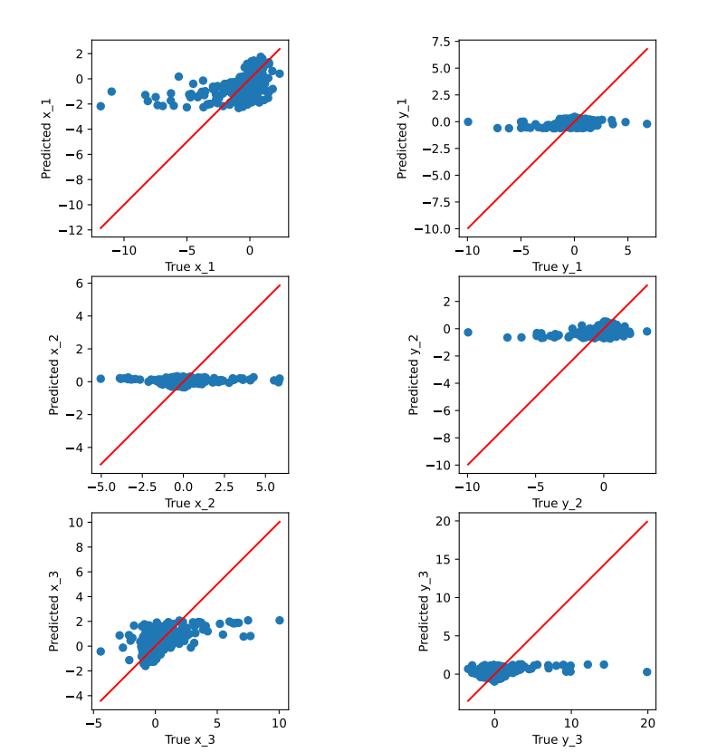
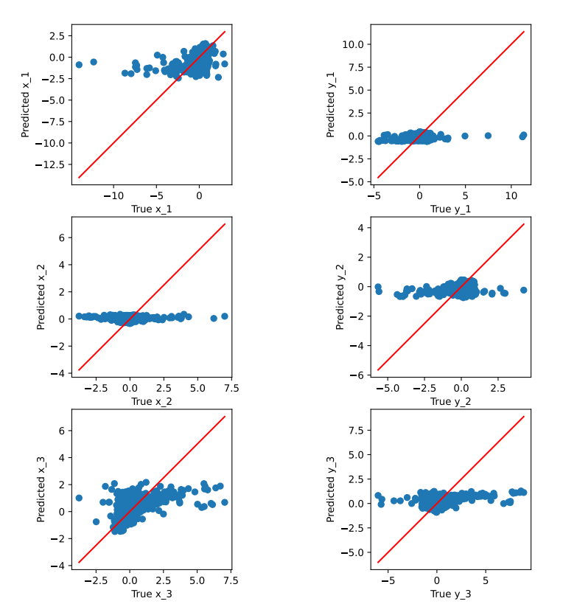
Train Plot Val Plot

Slide 13
Analysis
It’s possible to see directly the main characterisc of the baseline model, it’s linear. A clear blue line is displayed in the plots.
The two plots are not significantly different, meaning that the model has learned the underlying patterns.
Since the underlying patterns were learned in the training data well, the model performed well on the validation data, presenting a similar RMSE.
In case that the plots would be different, this could indicate that the model is overfitting the training data and not generalizing well to new data.
After the submission to Kaggle, the RMSE value was very similar.
In summary, it’s possible to conclude that the model is a well-performing model, since the diferences between the two plots are not so significant, and the value computed by Kaggle has no large discrepancies.

Slide 14
Task [2.1]
Notes:
Replicate this section for every task. Add slides as needed

Slide 15
What was done in task [2.1]
Change the split percentages to 1% of the dataset:
Decrease the percentages to 1% to run multiple tests quicly.
Develop a function to validate a polynomial regression model:
This function runs 10 times for 14 degrees.

Slide 16
What was done in task [2.1]
Develop a function to validate a polynomial regression model:
Looping the degrees:
Increasing the degrees allows more complex relationships to be captured between the features and targets;
Higher degree polynomials can better fit complex patterns and capture more complex relationships.
Starts by initialiazing some variables such as bestRmse, bestModel, bestDegree and bestAlpha:
Per loop, these variables will be compared with the previous best ones, in order to, in the end of the cycle, display the best parameters corresponding to the best performing model.

Slide 17
Concerns [2.1]
Develop a function to validate a polynomial regression model:
Increasing the degrees:
Memory usage: led to a significant increase in the memory required to store the expanded feature matrix. It was necessary to decrease the degree;
Computational complexity: the number of features generated by the polynomial transformation increases exponentially.

Slide 18
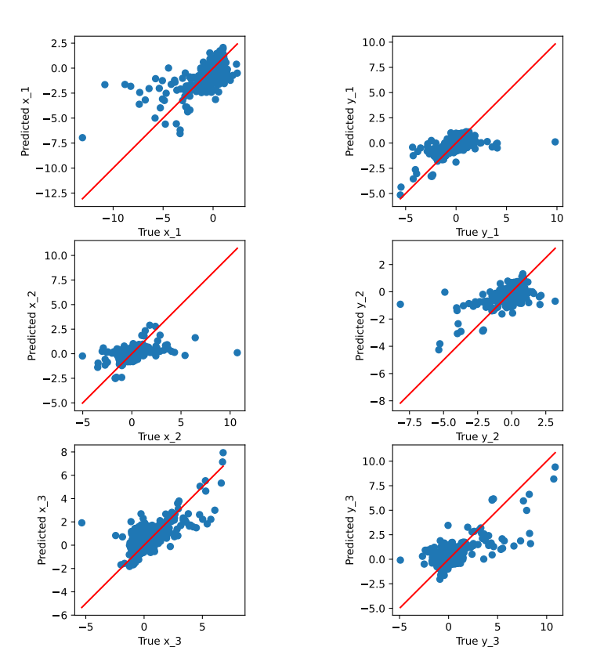
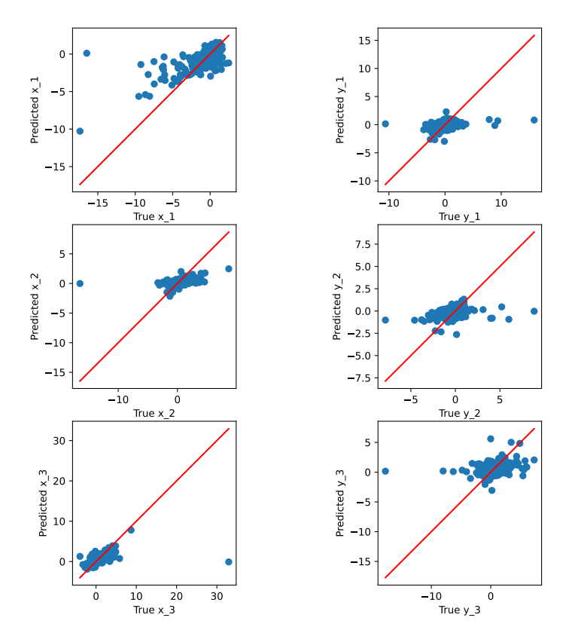
Train Plot Val Plot
Plots for Degree 7

Slide 19
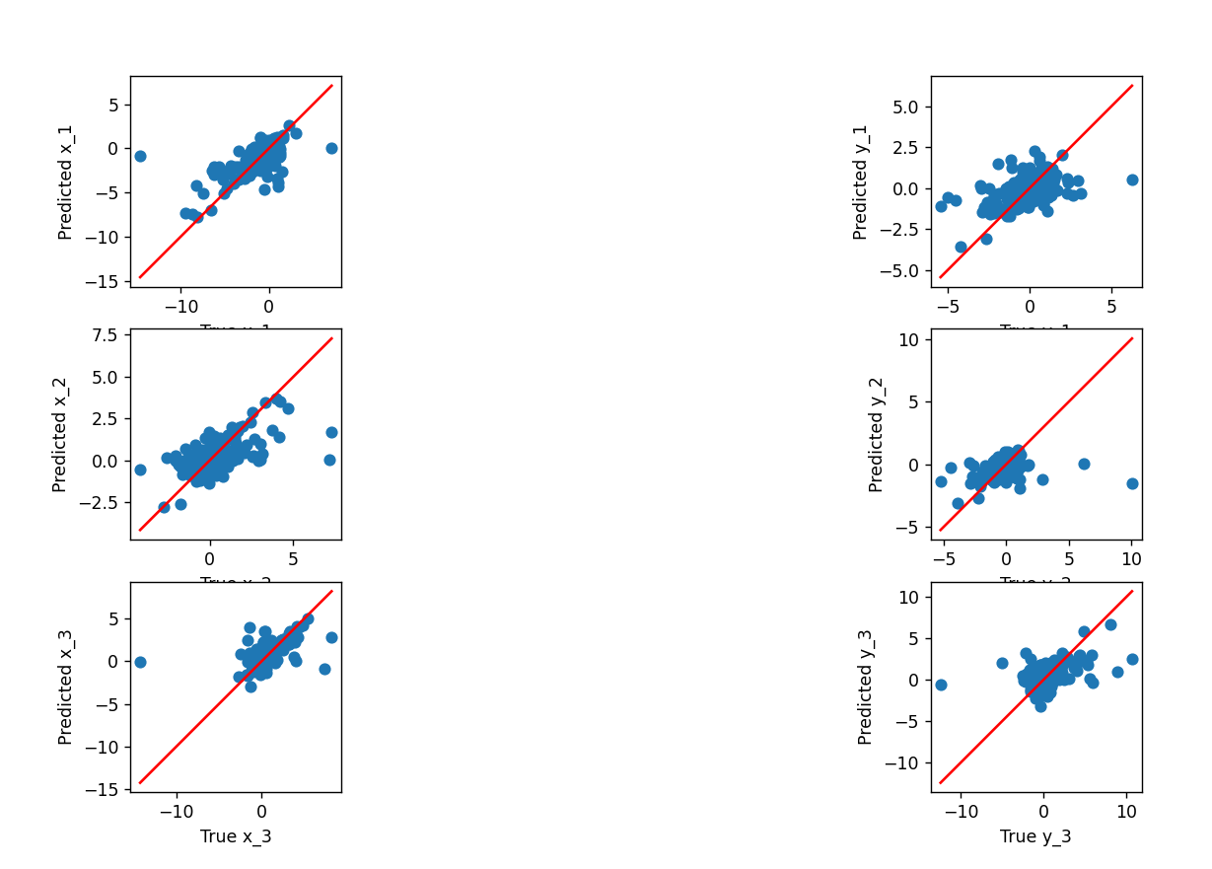
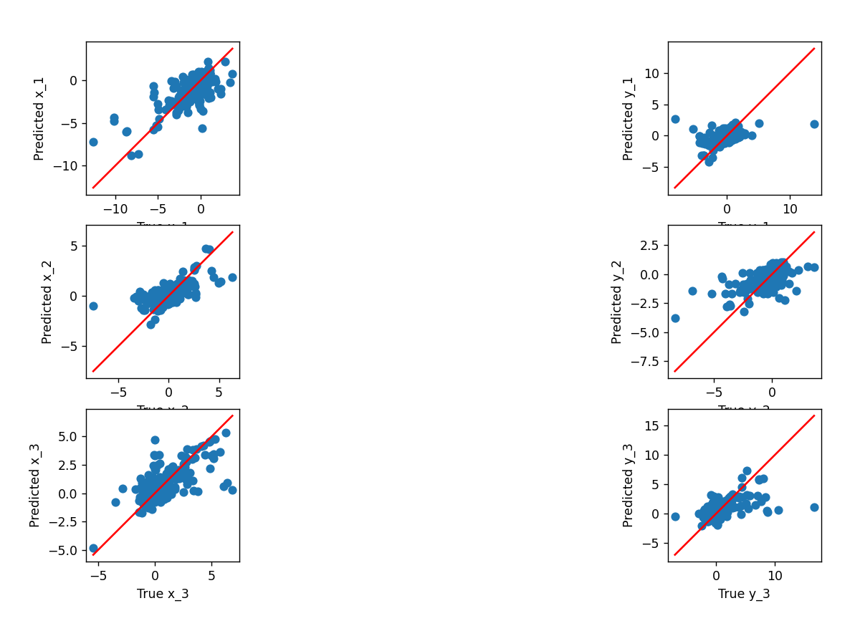
Train Plot Val Plot
Plot for Degree 14

Slide 20
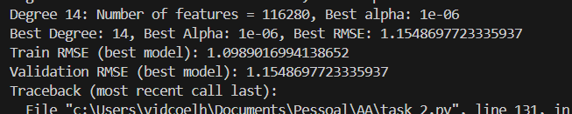

RMSE Values for Degree 14
RMSE Values for Degree 7

Slide 21
Analysis
As it’s possible to see by the previous images:
Comparing the plots degree 7 vs degree 14:
In the degree 14 it’s clear to see the curve of the polynomial model, and its precision;
At first sight, it’s easy to say that the degree 14 would be the best degree. Running all the degrees with the function, in the end the feedback was precisly that, but let’s now compare the RMSE values.
Comparing RMSE values degree 7 vs degree 14:
In the degree 14, the RMSE values between training and validation are significantly different. In contrast, for the degree 7 the difference is not so significant.
Looking at the values, it’s possible to conclude that the degree 14 is overfitting, creating this descrepancy between the RMSE values.
Comparing both together:
Although the plots are showing that the degree 14 is more precise, looking at the RMSE values it’s not possible to conclude so;
The degree 14 is overfitting, concluding that the target degree to choose needs to be in the lower so it doesn’t overfit and at the same time lowering the memory usage.

Slide 22
Analysis
In conclusion, having the memory usage and computational complexity in mind, and after the comparising between an higher degree and a medium one:
Although the higher degrees can give a better RMSE value, it might be overfitting, caused by capturing noise data;
Higher degrees are increasing the computational complexity by exponential;
To have a well-performing polynomial model, it’s needed balancing between those two factors.

Slide 23
Task [2.2]
Notes:
Replicate this section for every task. Add slides as needed

Slide 24
What was done in task [2.2]
Look into the polynomial model and compare it with the baseline model:
Compare plots;
Compare RMSE values;
Compare complexity vs precision.

Slide 25
Train Plot Val Plot
Baseline Model

Slide 26
Train Plot Val Plot
Polynomial Regression Model

Slide 27
Analysis
Compare the plots:
It’s easy to see the main difference between both models:
The baseline model is linear, and it’s clear to see the line;
The polynomial model is superlinear, and it’s possible to see the curve/diagonal, due to the increasing of the degrees.
Precision on the true values:
The baseline model is not so precise as it’s possible to see in the plots that the predicted values got “lost” from the true values;
The polynomial model is more precise, not having so much values far from the true values.

Slide 28
Analysis
Compare the RMSE values:
Baseline model RMSE ~= 1.43 vs Polynomial model RMSE ~= 1.22:
This comparison suggests that the polynomial model captures the underlying relationships in the data more effectively;
Both have a well-performing model, since the local values are similar to the ones computed by Kaggle.
Compare complexity vs precision:
The polynomial model is more complex than the baseline model, as it shows better precision;
The increased complexity should be monitored to avoid overfitting, especially if the polynomial degree is high.
In conclusion, the polynomial model is better, but it requires a balancing between the complexity and the risk of overfitting. Experimentation and iterative testing are key points for the polynomial model.

Slide 29
Task [3.1]
Notes:
Replicate this section for every task. Add slides as needed

Slide 30
What was done in task [3.1]
Explore features:
Verify linear relationships between them;
Eliminate the more redundant variables;
Check the impact on eliminating each variable on the baseline model.

Slide 31
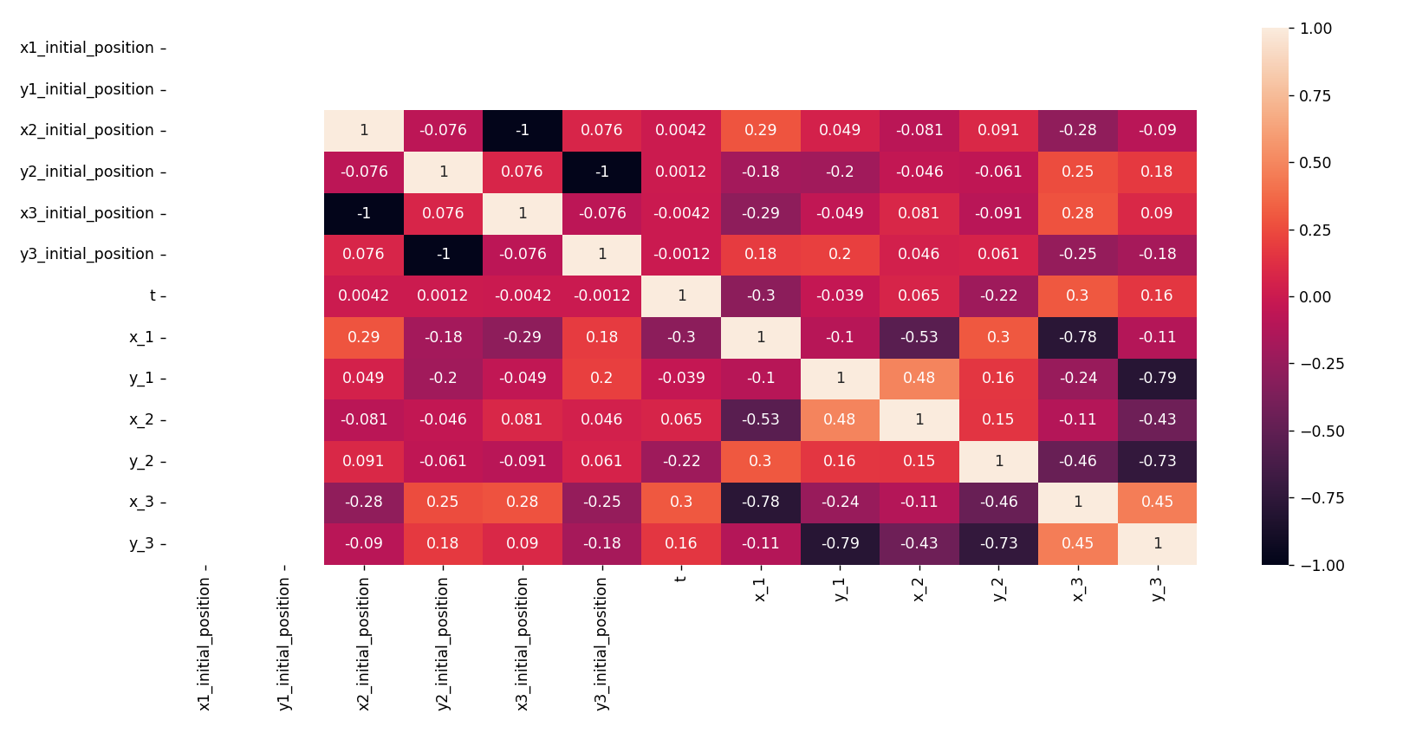
Three topics are visible in the previous correlation map:
x1_initial_position and y1_initial_position have no values/no correlation with other features, so it can be removed;
x3_initial_position and x2_initial_position are highly correlated, so one of them should be removed;
y3_initial_position and y2_initial_position are highly correlated, so one of them should be removed.

Slide 32
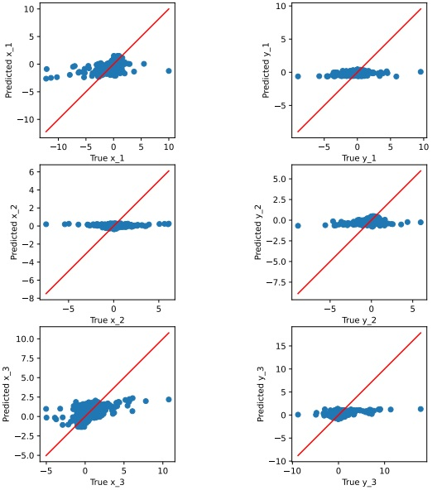
After x1_initial_position and y1_initial_position removal:
No big changes occurred in the baseline model RMSE values, that would confirm the independence of the eliminated features;
The new training plot is displayed above, with no big changes as well.

Slide 33
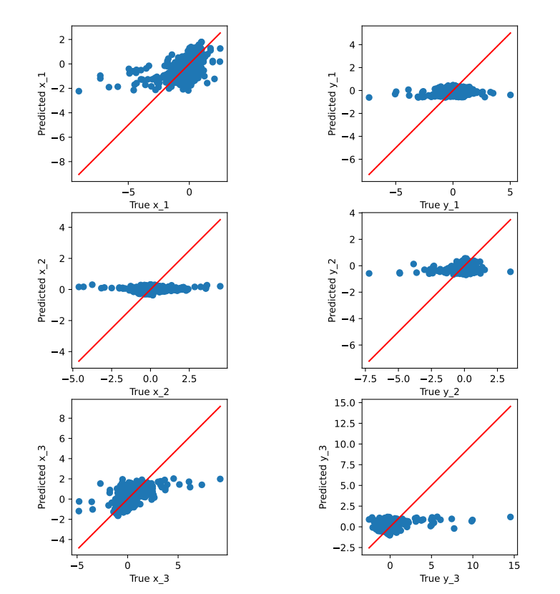
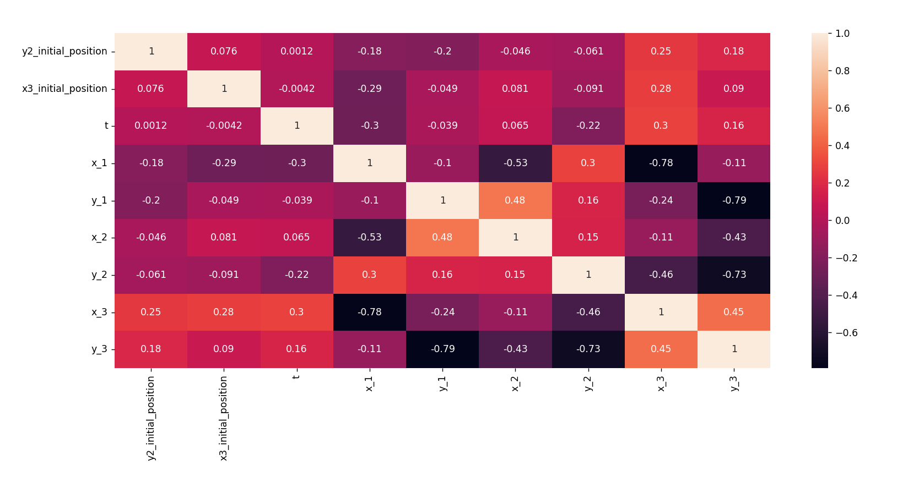
After x2_initial_position and y3_initial_position removal:
No big changes occurred in the baseline model RMSE values, that would confirm the model is stable, and suggests that the remaining features are sufficient to capture the essential patterns in the data;
The new training plot is displayed above, with no big changes as well;
The correlation map is no longer showing correlation between features.

Slide 34
Analysis
By eliminating the selected features, no big changes occured in the model, plots and RMSE.
With this there are some positive aspects to conclude:
The model proves stability;
The model is reducing complexity;
The model is focusing on important features;
The model is reducing the probability of overfitting.

Slide 35
Task [3.2]
Notes:
Replicate this section for every task. Add slides as needed

Slide 36
What was done in task [3.2]
Apply the reduced features to the polynomial model
Compare the polynomial model with reduced features and without the reduced features:
Compare plots;
Compare RMSE values;
Compare complexity vs precision.

Slide 37
Train Plot Val Plot
Not reduced features

Slide 38
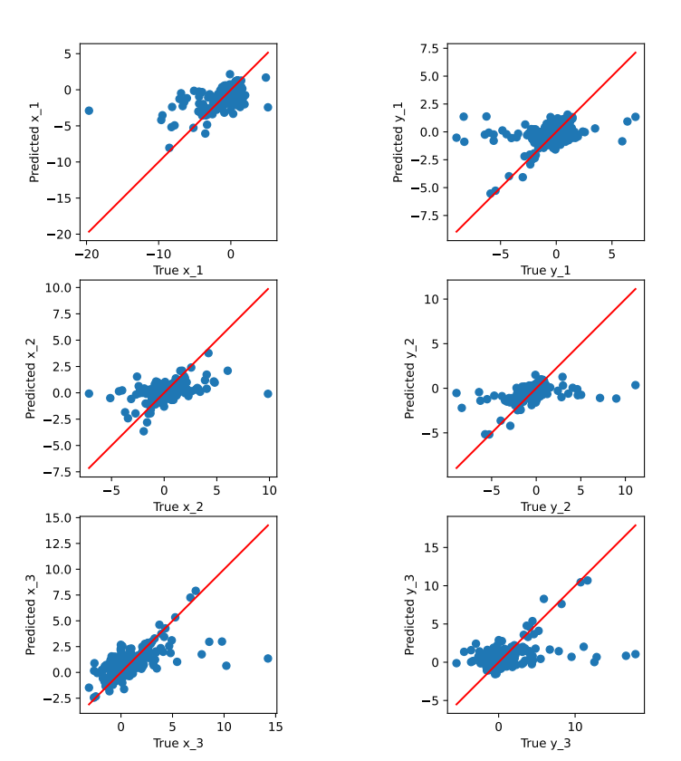
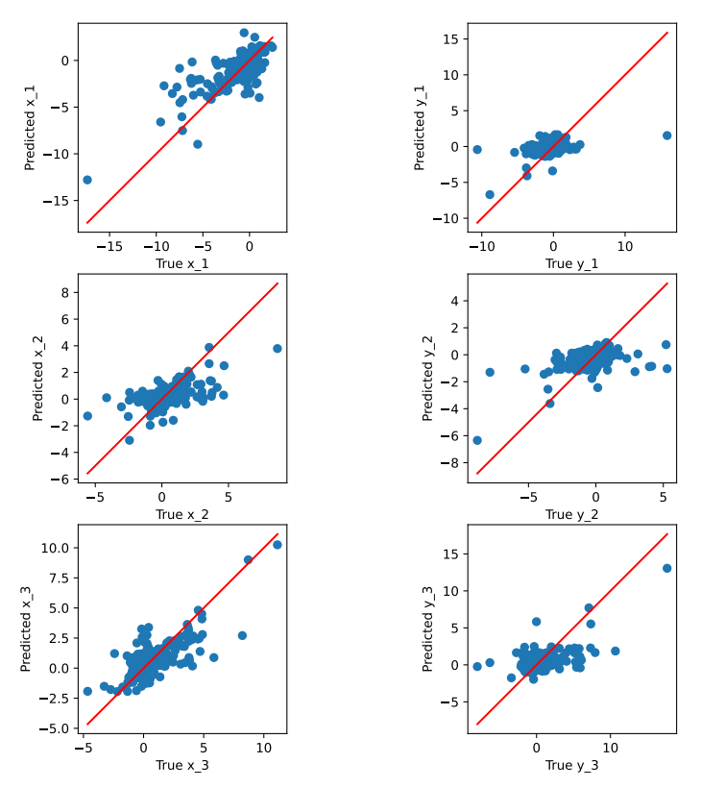
Reduced features
Train Plot Val Plot

Slide 39
Analysis
Compare the plots:
Polynomial curve/diagonal:
It’s easier to identify a clear curve/diagonal on the polynomial model with reduced features.
Precision on the true values:
The polynomial model with reduced features has more precision, as it’s possible to see that the predicted values are closer to the true ones.

Slide 40
Analysis
Compare the RMSE values:
Polynomial model with reduced features RMSE ~= 1.19 vs Polynomial model without reduced features RMSE ~= 1.22:
This comparison suggests that the polynomial model with reduced features is more effective;
Both have a well-performing model, since the local values are similar to the ones computed by Kaggle.
Compare complexity vs precision:
The complexity is reduced when the non significant features are eliminated;
The precision is increased when the non significant features are eliminated.
In conclusion:
The features selected to be eliminated were actually non-significant features, as we saw that the RMSE value is better;
Reducing the features, it’s reducing the risk of overfitting as well, that allows the degree to be increased to 14;
By reducing the features, it’s reducing the complexity of the model as well, and permitting that the model can use more memory.

Slide 41
Task [3.3]
Notes:
Replicate this section for every task. Add slides as needed

Slide 42
What was done in task [3.3]
Explore features:
Identify and create new features;
Check the impact on adding new features on the baseline model.

Slide 43
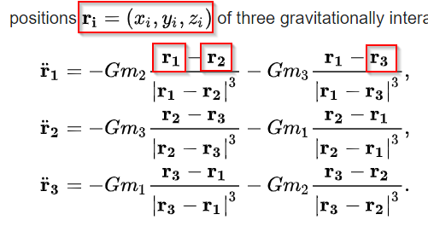
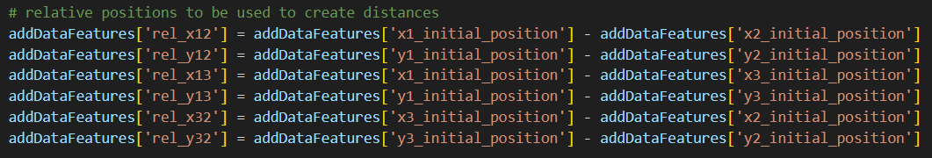
What was done in task [3.3]
Identify and create new features:
Explore the wiki page:
Relative positions that are used to calculate the Newton equations of motion for vector positions:

Slide 44
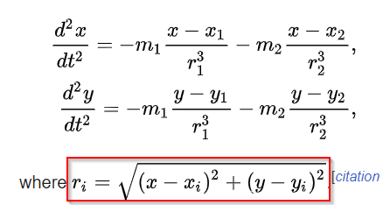
What was done in task [3.3]
Identify and create new features:
Explore the wiki page:
Distance between masses that are used to calculate the motion of the planetoid:

Slide 45
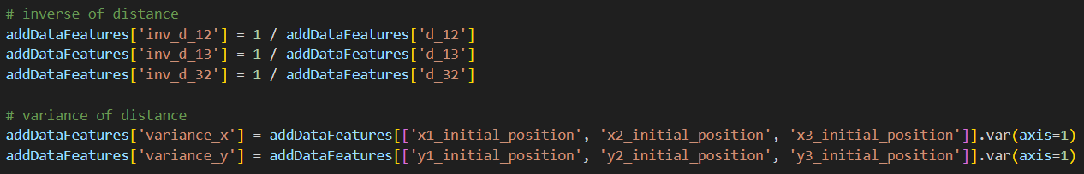
What was done in task [3.3]
Identify and create new features:
Inverse and variance of distance between masses:
These can help to capture more complex relationships.

Slide 46
Analysis
Comparing the RMSE values, it’s clear to conclude that the new features were able to improve the baseline model. The submission of the baseline model without new features, on Kaggle was ~=1.43, and the one with the new features was ~=1.37.
In conclusion, the more features the baseline model has, the more precise it will be. This occurs because the additional features can capture more information and patterns in the data, which leads to better predictions (better RMSE values).

Slide 47
Task [3.4]
Notes:
Replicate this section for every task. Add slides as needed

Slide 48
What was done in task [3.4]
Apply the new features to the polynomial model
Compare the polynomial model with new features and without the new features:
Compare plots;
Compare RMSE values;
Compare complexity vs precision.
Compare polynomial model, polynomial model with reduced features and polynomial model with new features

Slide 49
Train Plot Val Plot
No new features

Slide 50
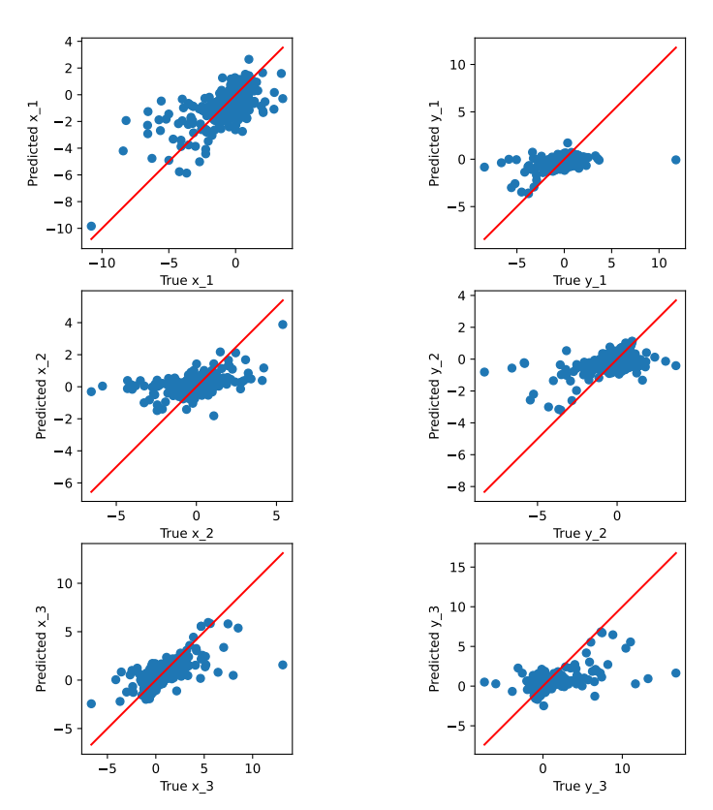
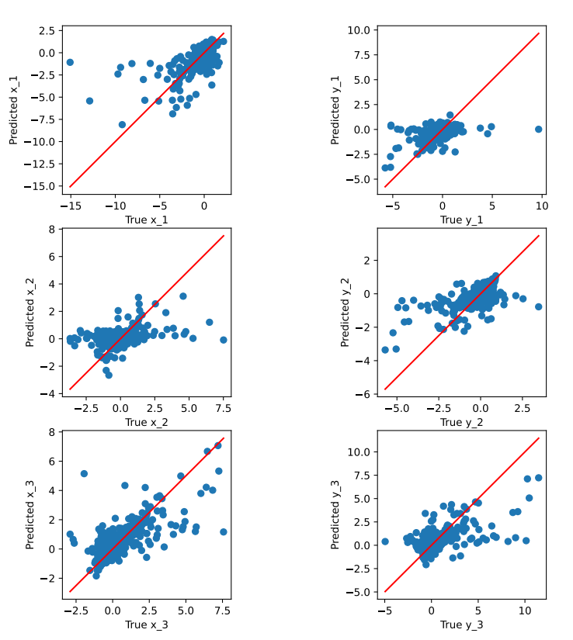
With new features
Train Plot Val Plot

Slide 51
Analysis
Compare the plots:
Spread:
The plot for the polynomial model, with the new features, is more spreaded along the diagonal (true values). In contrast, the polynomial model, without the new features, is more compact in one point of the diagonal. The curve is more visible when adding the new features;
The polynomial model with the new features, was able to capture more complex relationships.
Precision on the true values:
The polynomial model with new features is not more accurate than the polynomial model without the new features;
The new features added to the model were not significantly improving the model.

Slide 52
Analysis
Compare the RMSE values:
Polynomial model with new features RMSE ~= 1.22 vs Polynomial model without reduced features RMSE ~= 1.22:
This comparison suggests, that the new features added to the polynomial model are not improving the model;
Both have a well-performing model, since the local values are similar to the ones computed by Kaggle;
On the other hand, the polynomial model without the new features is already capturing most of the relevant complex information of the data.
Compare complexity vs precision:
The complexity is augmented when new features are added to the model;
The precision is maintained, when the new features added to the model are not offering a good value.
In conclusion:
The features selected to be added were not the best, as we saw that the RMSE values are very similar;
Adding new features, it’s augmenting the complexity.

Slide 53
Task [4.1]
Notes:
Replicate this section for every task. Add slides as needed

Slide 54
What was done in task [4.1]
Develop a function to validate a kNN regression model:
Looping 14 k’s:
Increasing the k value stands for increasing the number of neighbors considered for prediction.
Starts by initialiazing some variables such as bestRmse, bestModel, bestK:
Per loop, these variables will be compared with the previous best ones, in order to, in the end of the cycle, display the best parameters corresponding to the best performing model.

Slide 55
Concerns [4.1]
Value of k:
Small value:
Results in a more flexible model that fits the training data closely;
It can lead to overfitting.
Big value:
Results in a more robust and complex model;
It can lead to underfitting, due to the complexity of the original dataset.

Slide 56
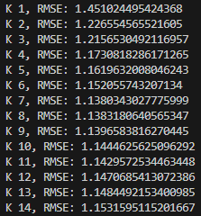
Analysis
Which k is better?
As concluded before, high values of k can lead to underfitting, while small values of k can lead to overfitting.
By looking, at the RMSE values, calculated by the implemented function:
From k=1 to k=6:
The RMSE value decreases significantly, this suggests that by increasing the number of nearest neighbors in the prediction, the model improves.
From k=7 to k=9:
The RMSE value is not suffering significant changes, this suggests that between the middle values of k, the model’s finds its balance.
From k=10 to k=14:
The RMSE value is slightly increasing, that suggests that having too many neighbors may result in irrelevant data.
It’s then possible to conclude that the best k value, is 7:
It has the best RMSE value;
It finds the balance between fitting and complexity.

Slide 57
Task [4.2]
Notes:
Replicate this section for every task. Add slides as needed

Slide 58
What was done in task [4.2]
Compare the nonparametric model with the baseline model and the polynomial model with reduced features:
Compare plots;
Compare RMSE values.

Slide 59
Train Plot Val Plot
Baseline Model

Slide 60
Polynomial with reduced features
Train Plot Val Plot

Slide 61
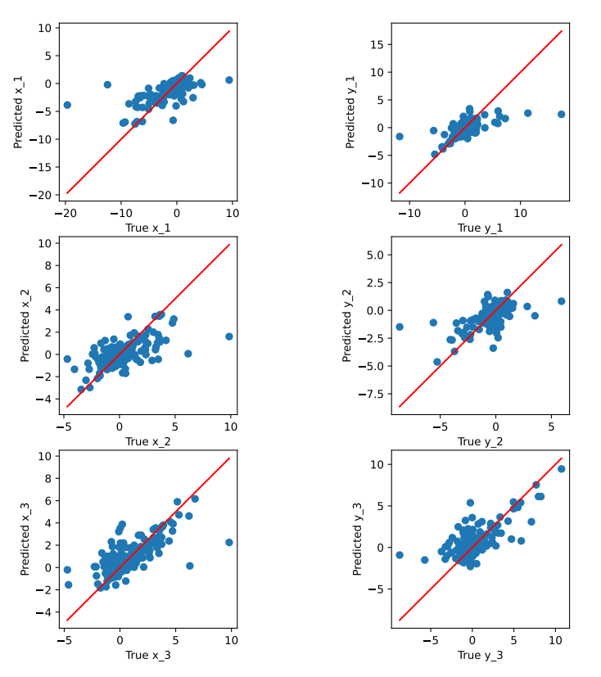
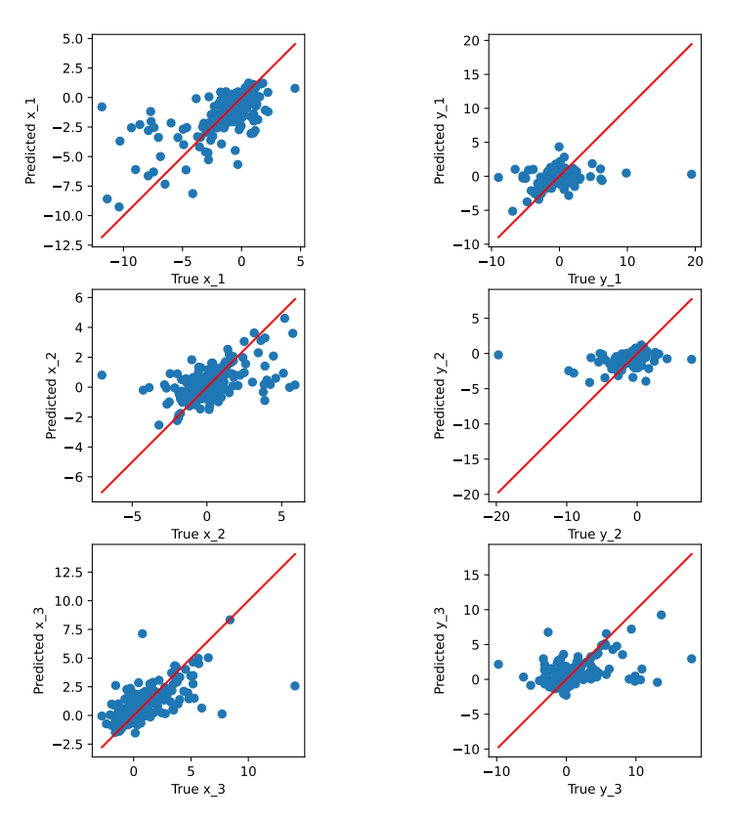
Nonparametric model
Train Plot Val Plot

Slide 62
Analysis
Compare the plots:
Baseline model:
It’s simplier, to understand, to implement and to analise;
It’s oversimplying the relationships in the data, resulting in lower precision, since the problem/data is complex.
Polynomial model with reduced features:
It’s possible to identify the curve, and more precision in the prediction, due to being able to capture nonlinear relationships.
Nonparametric model:
It’s more precise, due to the complexity of the data, this model is able to capture complex patterns in the data without looking on the predefined data;
Not relying on the predefined data/relationships, but in its neighbors.

Slide 63
Analysis
Compare the RMSE values:
Polynomial model with reduced features RMSE ~= 1.19 vs baseline model RMSE ~= 1.37 vs nonparametric model RMSE ~= 1.17:
This comparison suggests that the nonparametric model is more effective;
Due to being the best model to fit in a complex problem, it performs better. By capturing more complex patterns, due to not relying on predefined assumptions.
In conclusion:
The best model is the nonparametric model:
Is more flexible;
Does not rely on predefined assumptions;
Has advantages when the relationships between features and targets are highly complex and nonlinear;
Although it’s the best model, it needs attention to the points that were described as concerns.

Slide 64
Overall assessment

Slide 65
What went wrong
A lot of time to explore the data and understand the problem:
Difficulties to start.
Adding new features to the polynomial model:
We were not able to improve the model.

Slide 66
What went great
After the first talk with the teacher:
It was easier to understand the problem when explained in person.
Understanding/Learning the difference between the baseline model and the polynomial model:
From the exploration of the data, to the splitting of the data and the building of the model, it was clear to understand the process and how to implement it.

